Slide 1

Consumer Segmentation Analytics for AXANTEUS
A Comprehensive Approach to Consumer Behavior and Predictive Modeling
CSDA 6010 Project 3 - Subash Yadav
Prof. JP Wang

Slide 2
Business Problem
Understanding Consumer Behavior
Targeting Marketing Strategies Effectively
Predicting Consumer Loyalty & Engagement

Slide 3
Business Goal
Develop Consumer Segmentation: Create distinct consumer segments using behavior-based clustering techniques, focusing on purchase behavior and motivations to enable precise and actionable marketing strategies.
Enhance Targeted Marketing: Utilize predictive models to identify value-conscious consumers and brand-loyal customers, enabling clients to implement deal-driven promotions and loyalty-focused campaigns.
Improve Customer Engagement: Provide AXANTEUS with data-driven insights that support the optimization of loyalty programs and personalized rewards to foster long-term consumer retention and satisfaction.

Slide 4
Analytical Goal & Approach
The analytical goal of this project is to develop a behavior-based consumer segmentation model to provide deeper insights into purchasing behaviors and motivations, enabling AXANTEUS to implement targeted marketing and loyalty strategies.
Phase 1: Clustering Analysis (Unsupervised)
Goal: Segment consumers into distinct groups based on purchase behaviors (e.g., transaction frequency, purchase volume, brand loyalty) and purchase motivations (e.g., price sensitivity, brand preferences).
Objective: Create actionable consumer profiles, such as "price-sensitive frequent buyers" or "brand-loyal customers."
Phase 2: Classification and Prediction (Supervised)
Value-Conscious Classification: Identify price-sensitive consumers for deal-driven marketing.
Brand Loyalty Prediction: Forecast brand loyalty patterns to support loyalty and retention strategies.

Slide 5
Analytical Approach
The analytical approach focuses on a structured process across two phases: clustering for consumer segmentation and predictive modeling for actionable insights.
Data Exploration and Preprocessing
Conduct exploratory data analysis (EDA) to understand key variables and detect patterns.
Encode categorical variables and address missing values or outliers to ensure data readiness.
Clustering Analysis (Unsupervised)
Goal: Segment consumers based on purchase behavior (e.g., frequency, volume, loyalty) and motivations (e.g., price sensitivity, promotional responsiveness).
Apply K-means clustering and determine the optimal clusters using Elbow and Silhouette methods.
Analyze and evaluate cluster stability to create clear and actionable consumer profiles.
Classification and Prediction Models (Supervised)
Value-Conscious Classification:
Identify price-sensitive consumers using features like discount-purchase frequency and promotional responsiveness.
Employ Logistic Regression and Random Forest models for classification.
Brand Loyalty Prediction:
Forecast repeated brand purchases using transaction history and loyalty indicators.
Apply regression model for predictive accuracy.
Model Evaluation and Insights
Interpret outputs to identify key predictors driving value-consciousness and brand loyalty.
Generate actionable insights for targeted marketing and loyalty program design.

Slide 6
Dataset
Dataset Summary:
Size: 600 records with 46 variables.
Type: Demographic and transactional data.
Key Variables: Purchase frequency, brand loyalty, category diversity, affluence index, transaction volume, and price sensitivity.
Structure: Cleaned and structured data with no missing values but had zeros values.
Data Features:
Demographic Information: Age, gender, education, household size, affluence index.
Purchase Behavior: Number of transactions, total purchase volume, average transaction value, brand loyalty (brand runs).
Purchase Motivation: Responsiveness to discounts, category diversity, price sensitivity, and promotional behavior.
Brand, and Price Analysis: Responsiveness to brands, associated to price, price sensitivity.

Slide 7
Data Preprocessing
Variable | Zero Count | Issue | Imputation Strategy
SEC | 0 | No missing data | No imputation needed
FEH | 69 | Likely indicates unspecified eating habits | Not treated; values retained as is
MT | 69 | Represents a language code (0 is valid) | No imputation needed
SEX | 68 | Likely indicates unspecified gender | 0 - Treated as "Not Defined" to preserve data integrity
AGE | 0 | No missing data | No imputation needed
EDU | 73 | Missing education level | Replaced zeros with median of non-zero values
HS | 68 | Unrealistic zero values indicating missing household size | Replaced zeros with median of non-zero values
CHILD | 0 | No missing data; zero represents no children | No imputation needed
CS | 99 | Missing data for TV availability | Replaced zeros with mode (1, indicating "Available")
Affluence Index | 69 | Missing affluence information | Replaced zeros with median of non-zero values
Converted to Lowercase
Replaced Periods with Underscores
Renaming Columns

Slide 8
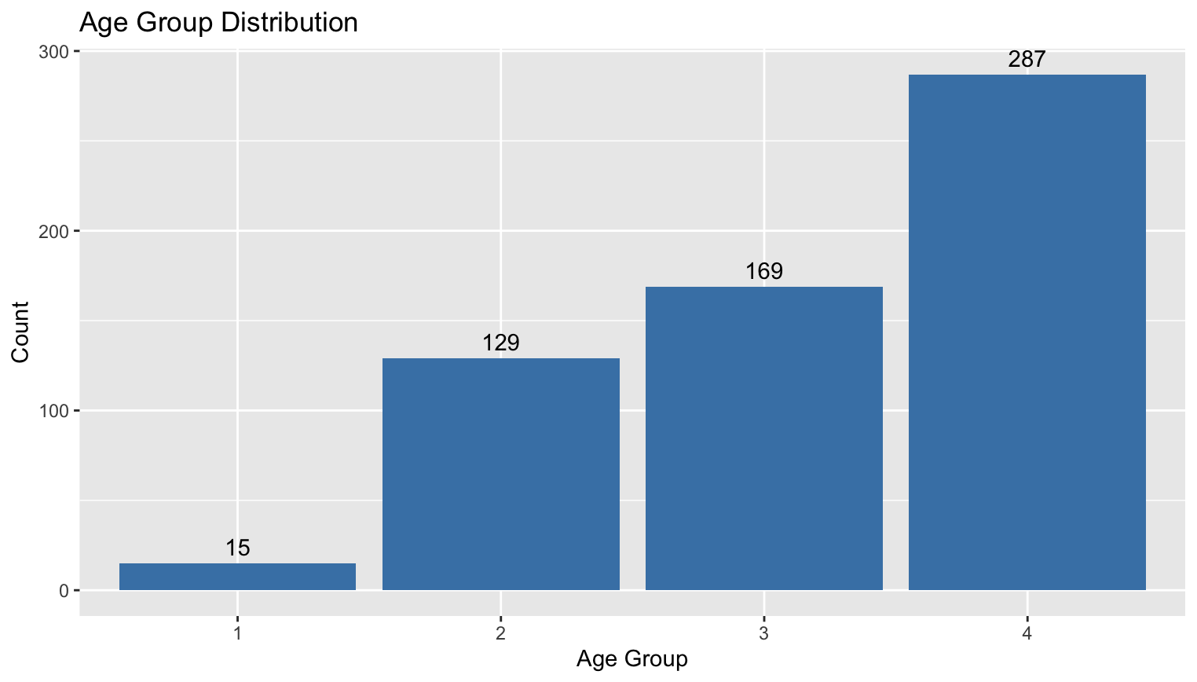
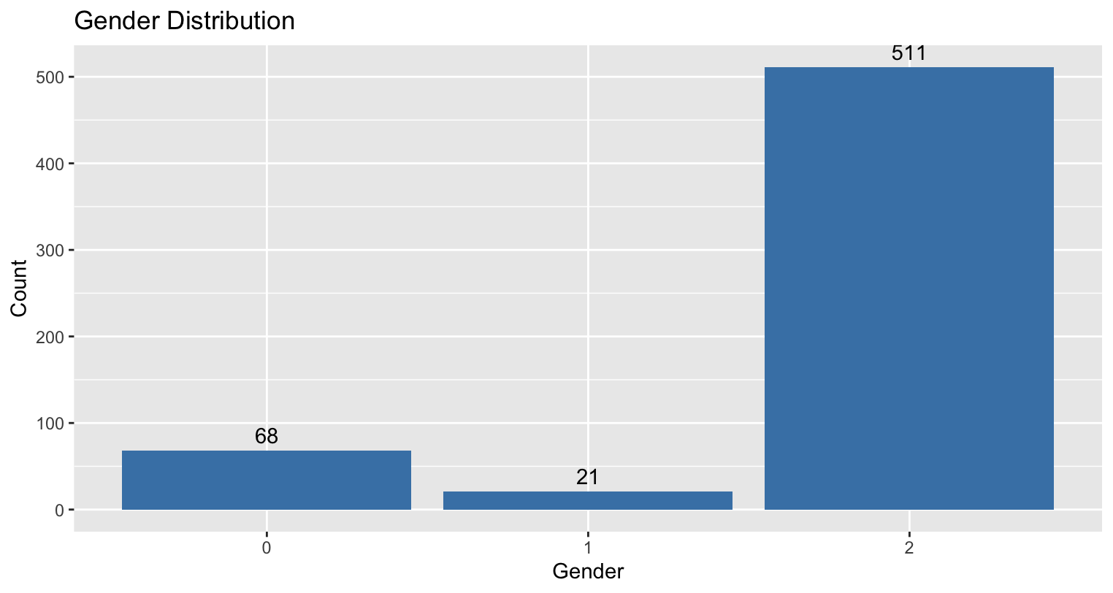
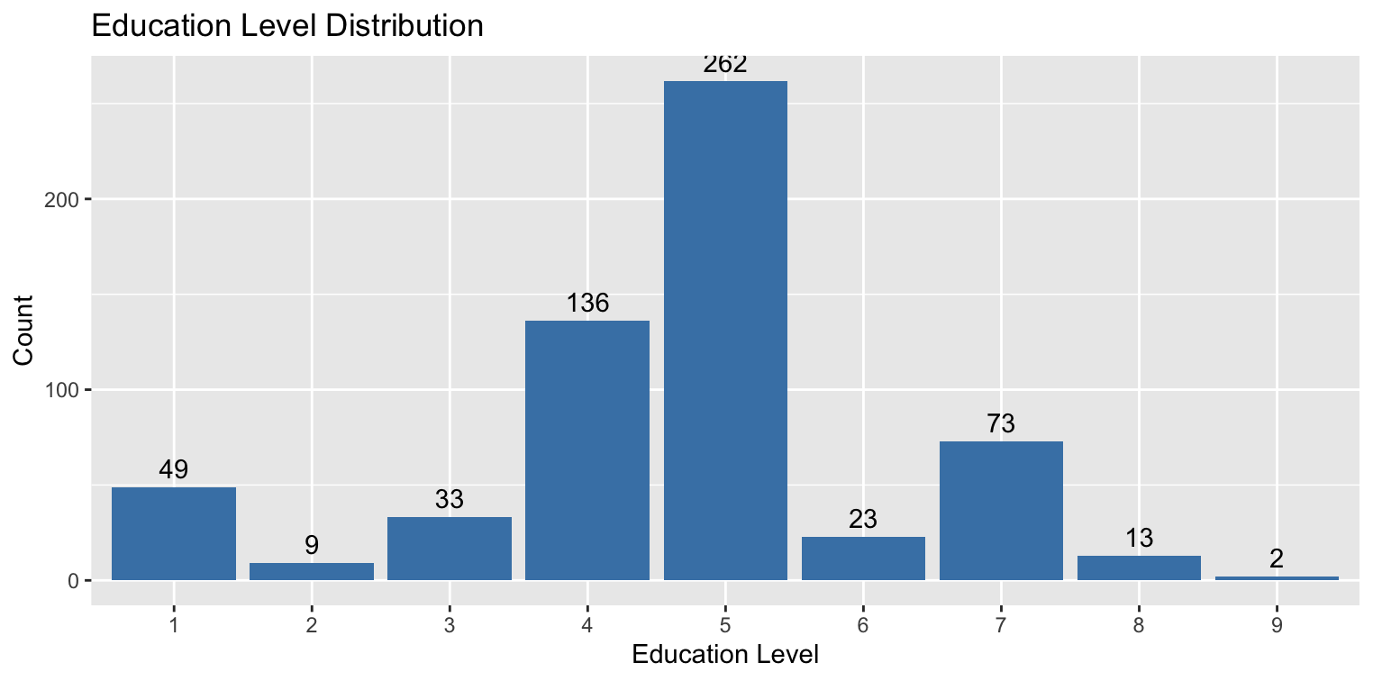
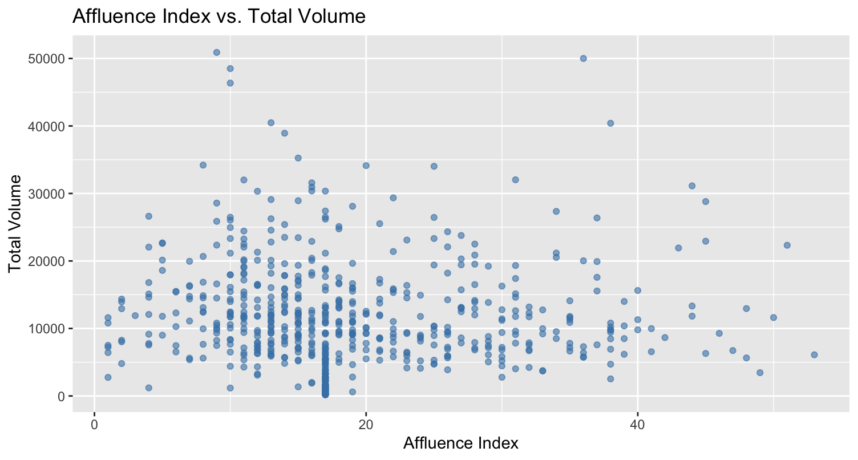
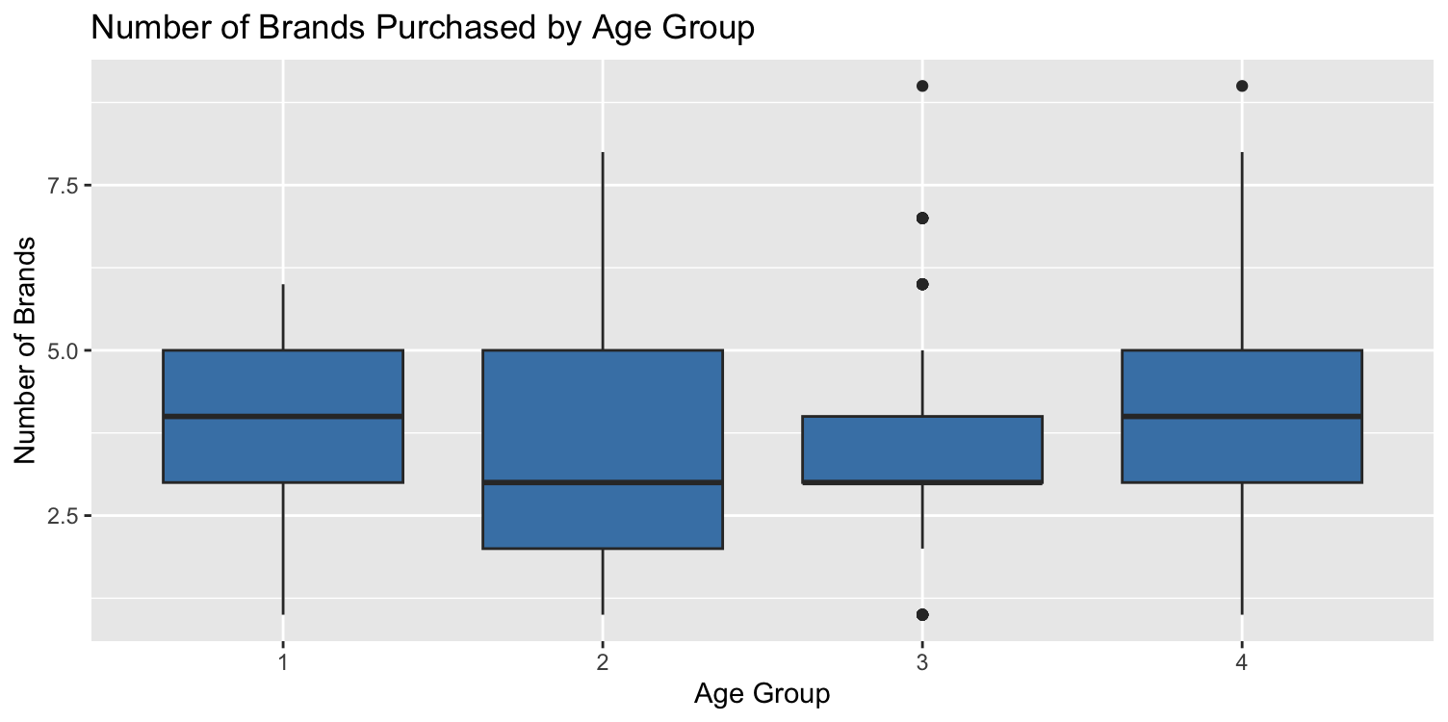
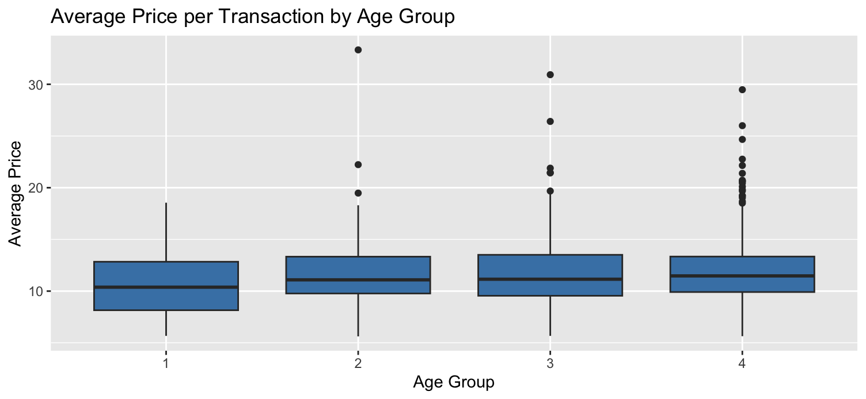
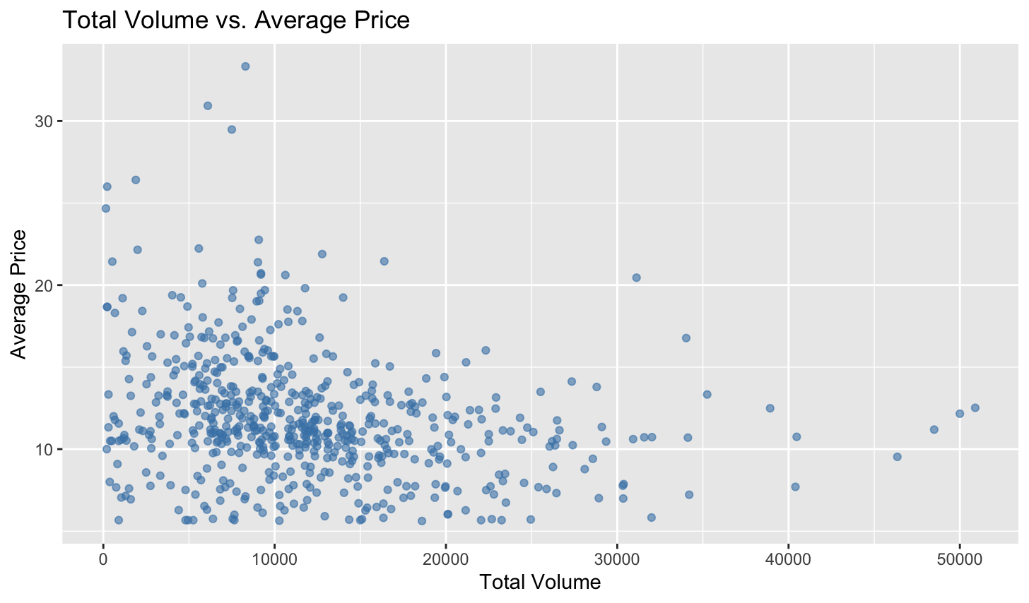
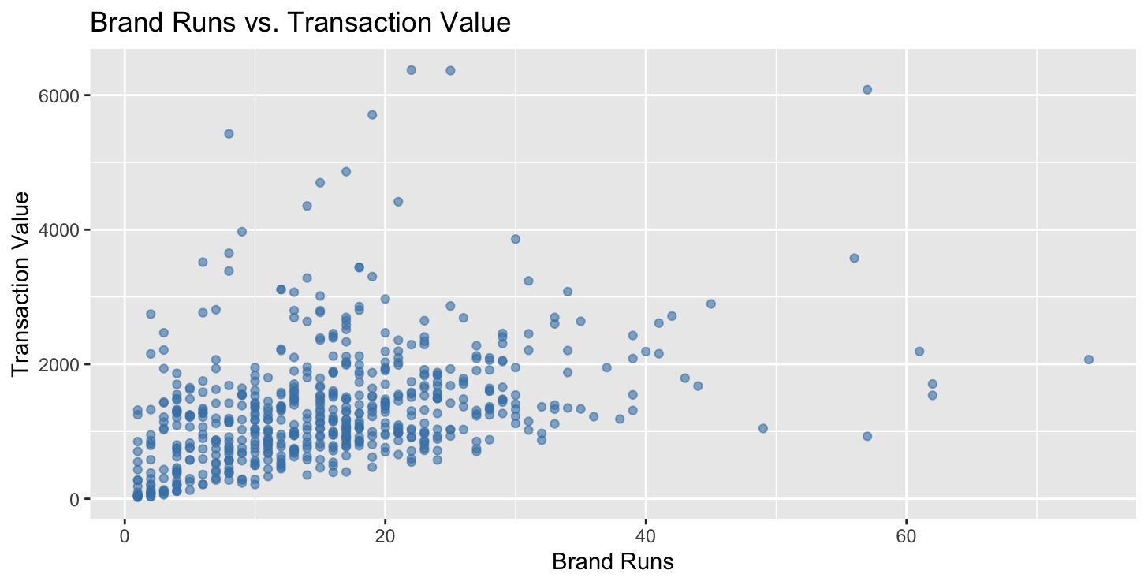
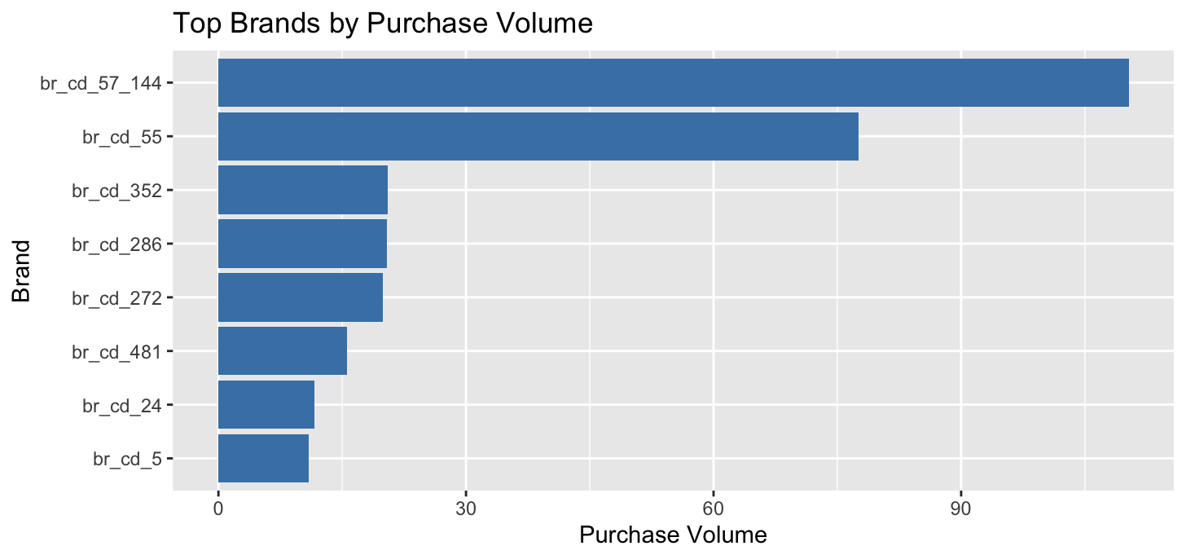
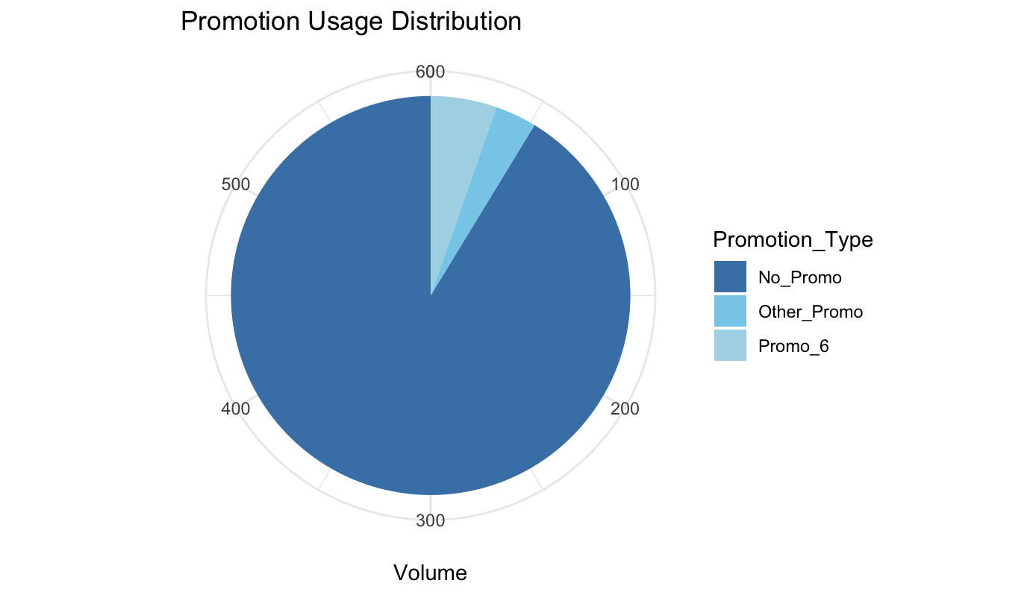
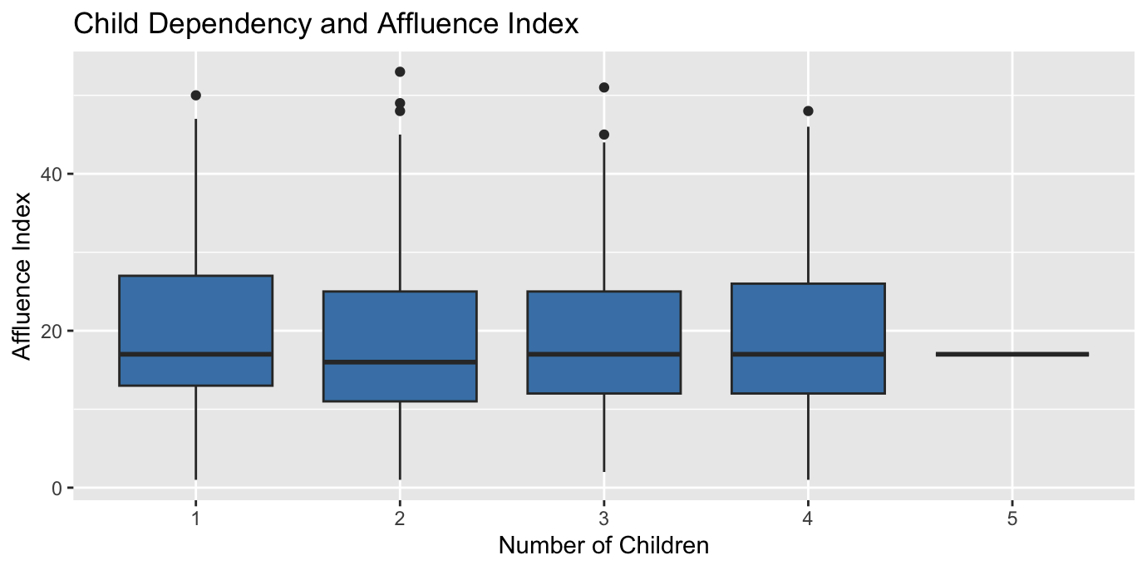
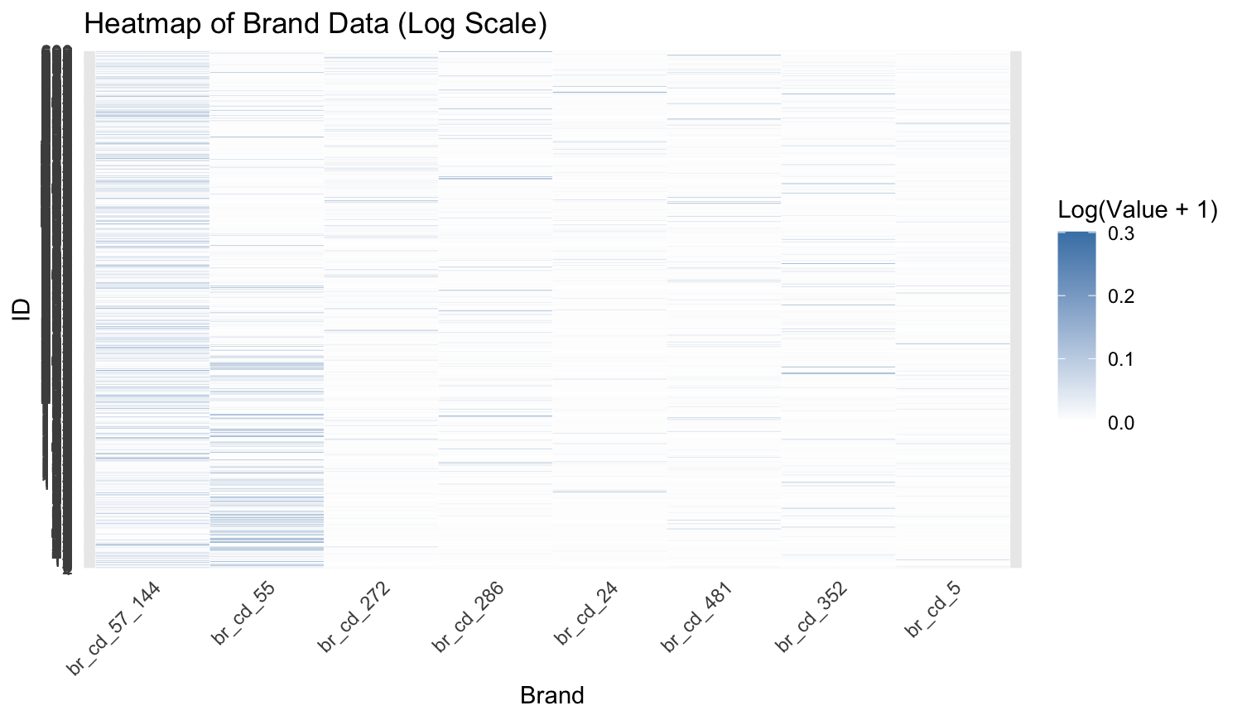
EDA

Slide 9
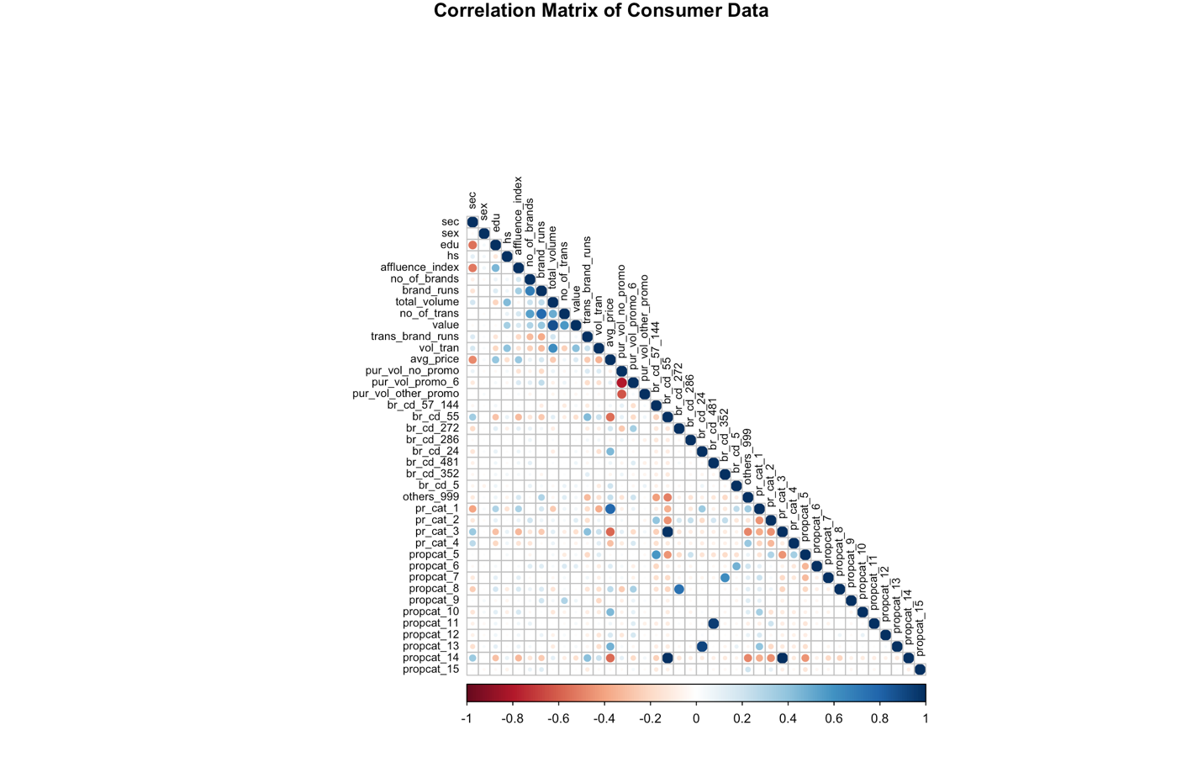
Correlation Analysis
No. | Variable 1 | Variable 2 | Correlation Value
1 | propcat_14 | pr_cat_3 | 0.9973
2 | propcat_14 | br_cd_55 | 0.9930
3 | pr_cat_3 | br_cd_55 | 0.9887
4 | propcat_11 | br_cd_481 | 0.9464
5 | propcat_13 | br_cd_24 | 0.9187
6 | value | total_volume | 0.8764
7 | pur_vol_promo_6 | pur_vol_no_promo | -0.7984
8 | pr_cat_1 | avg_price | 0.7861
9 | no_of_trans | brand_runs | 0.7743
10 | propcat_8 | br_cd_272 | 0.7432
11 | brand_runs | no_of_brands | 0.6890
12 | pur_vol_other_promo | pur_vol_no_promo | -0.6286
13 | propcat_7 | br_cd_352 | 0.6264
14 | vol_tran | total_volume | 0.6202
15 | br_cd_24 | propcat_13 | 0.9187
16 | br_cd_481 | propcat_11 | 0.9464
17 | br_cd_55 | propcat_14 | 0.9929
18 | pr_cat_3 | propcat_14 | 0.9973
19 | total_volume | vol_tran | 0.6202
20 | no_of_trans | brand_runs | 0.7743

Slide 10
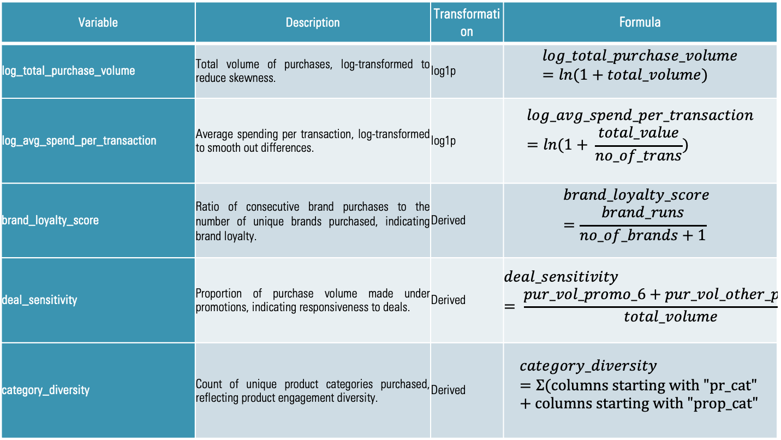
Data Transformation
Variable | Description | Transformation | Formula
log_total_purchase_volume | Total volume of purchases, log-transformed to reduce skewness. | log1p | $$log_total_purchase_volume=ln(1+total_volume)$$
log_avg_spend_per_transaction | Average spending per transaction, log-transformed to smooth out differences. | log1p | $$log_avg_spend_per_transaction=ln(1+ \frac{total_value}{no_of_trans})$$
brand_loyalty_score | Ratio of consecutive brand purchases to the number of unique brands purchased, indicating brand loyalty. | Derived | $$brand_loyalty_score =\frac{brand_runs}{no_of_brands+1}$$
deal_sensitivity | Proportion of purchase volume made under promotions, indicating responsiveness to deals. | Derived | $$deal_sensitivity = \frac{pur_vol_promo_6+pur_vol_other_promo}{total_volume}$$
category_diversity | Count of unique product categories purchased, reflecting product engagement diversity. | Derived | $$category_diversity=Σ(columns starting with "pr_cat" +columns starting with "prop_cat"$$

Slide 11
Feature Selection
Cluster Segment | Feature | Description
Purchase Behavior Cluster | log_total_purchase_volume | Represents total purchase activity on a logarithmic scale.
 | brand_loyalty_score | Quantifies loyalty toward specific brands.
 | no_of_trans | Total number of transactions made by the consumer.
Purchase Basis Cluster | deal_sensitivity | Measures responsiveness to promotions.
 | category_diversity | Captures the variety of product categories engaged by the consumer.
Combined Cluster | log_total_purchase_volume | Represents total purchase activity on a logarithmic scale.
 | brand_loyalty_score | Quantifies loyalty toward specific brands.
 | no_of_trans | Total number of transactions made by the consumer.
 | deal_sensitivity | Measures responsiveness to promotions.
 | category_diversity | Captures the variety of product categories engaged by the consumer.

Slide 12
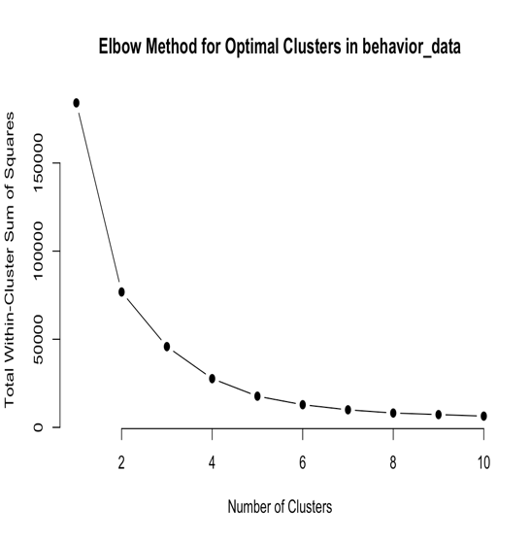
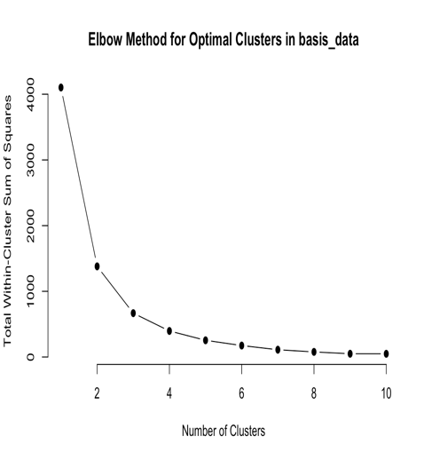
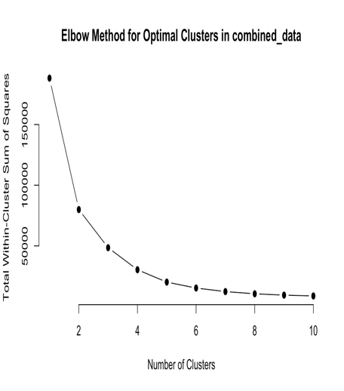
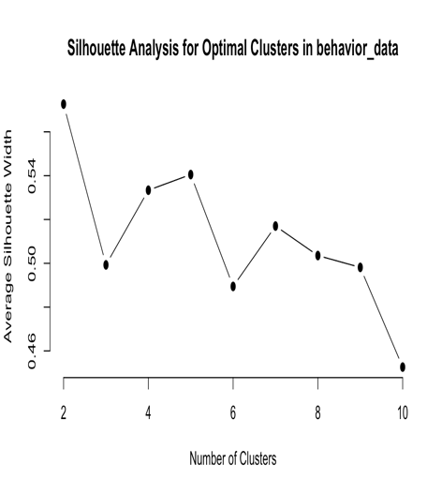
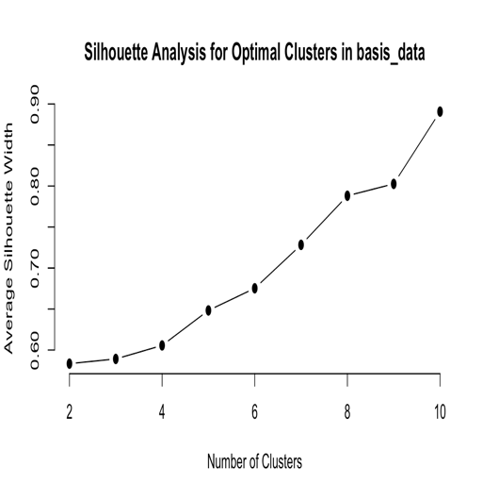
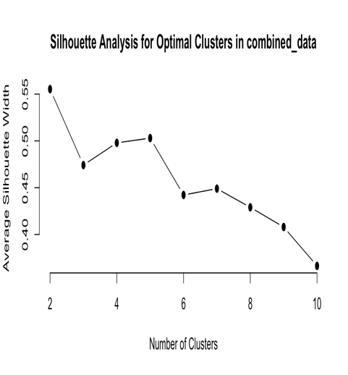
Elbow & Silhouette Analysis

Slide 13
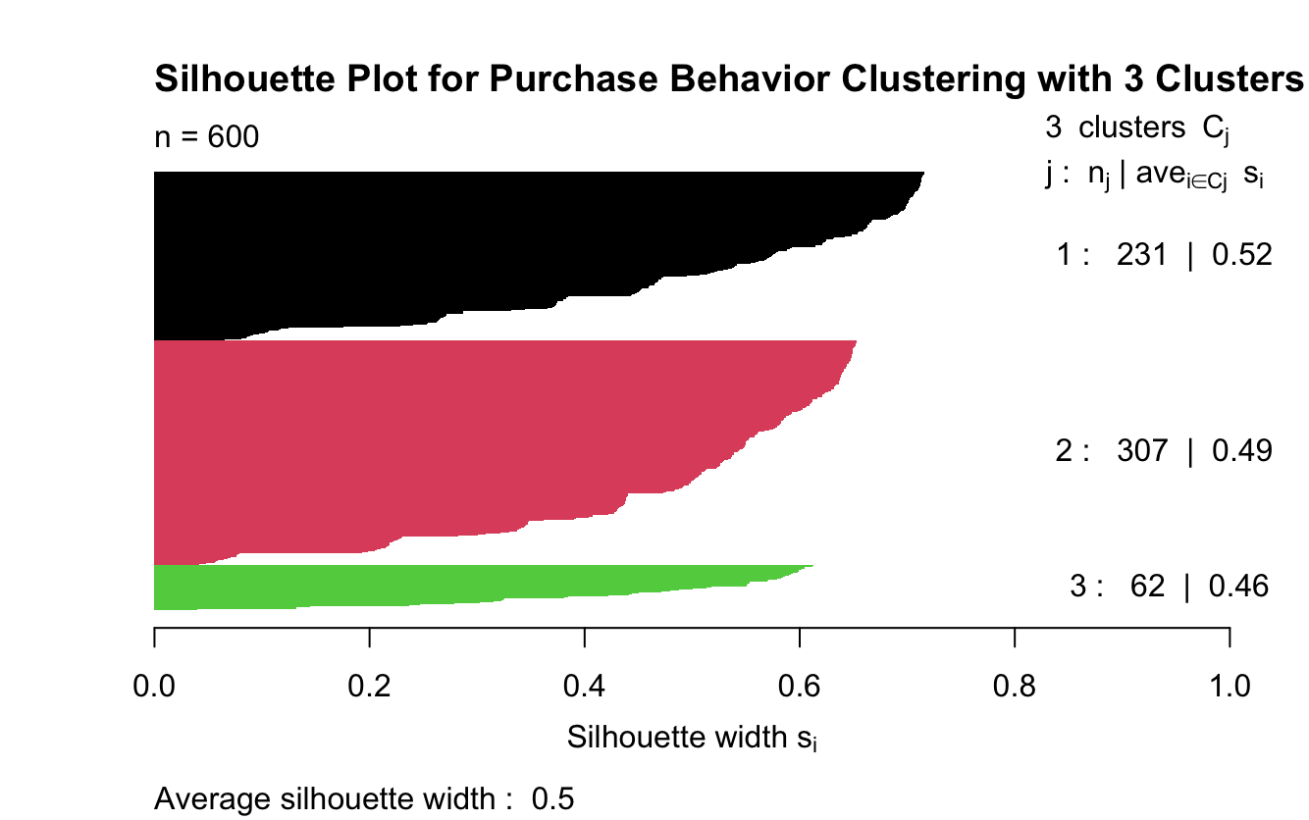
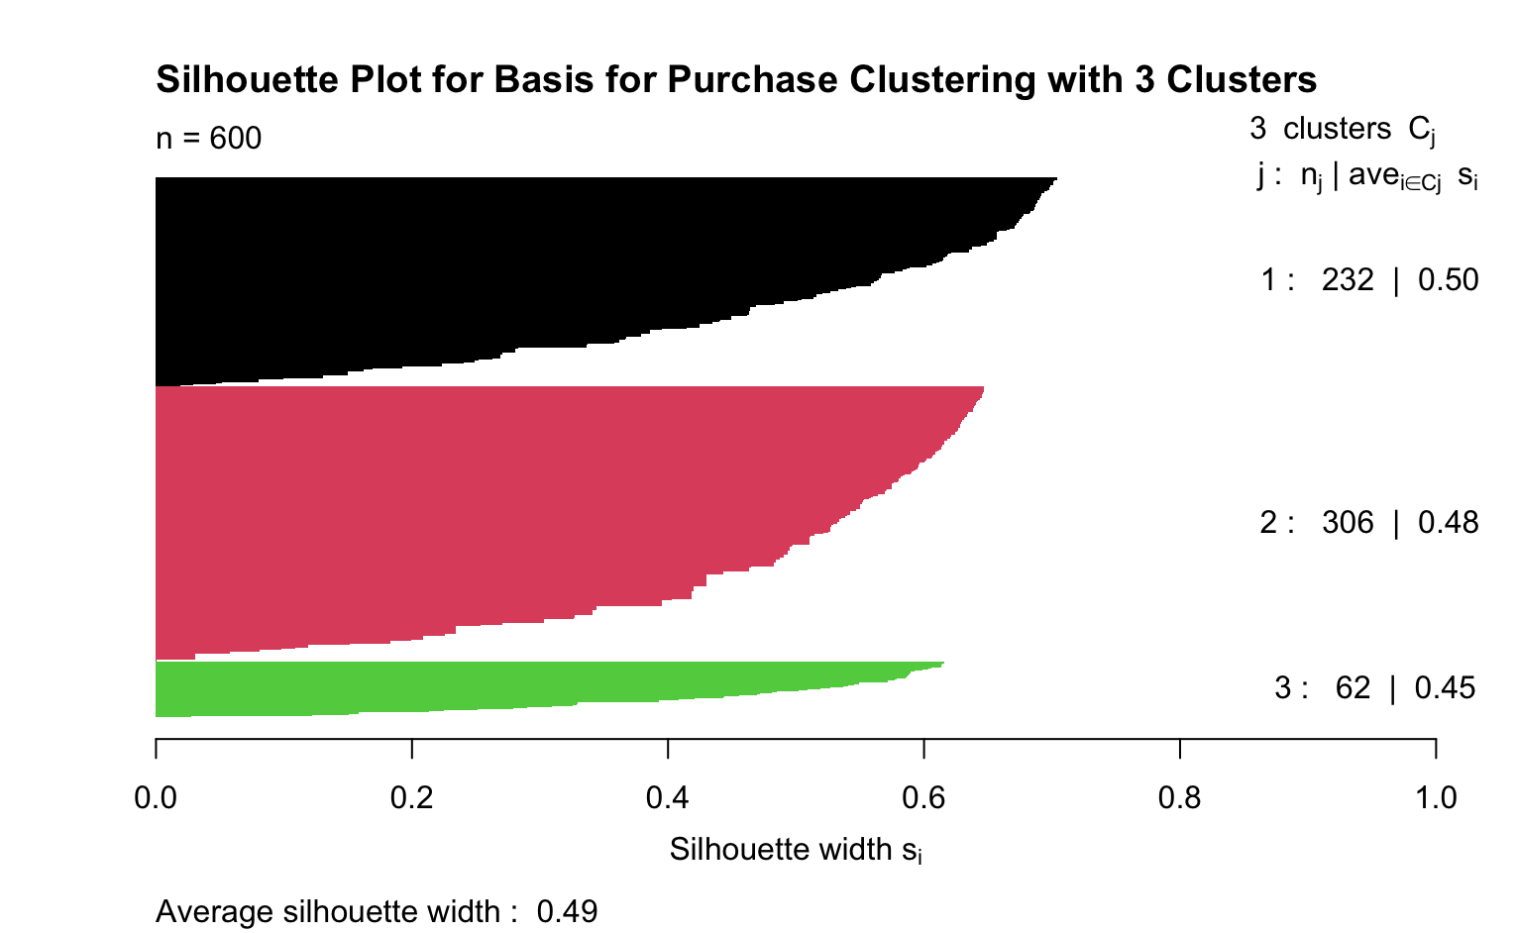
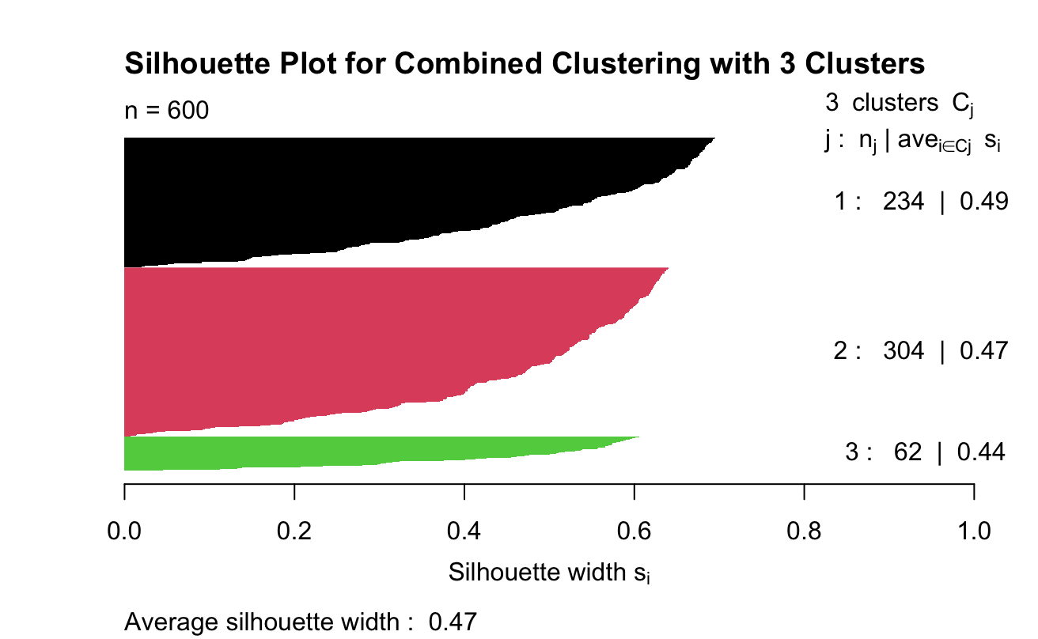
Clustering
Cluster 1: Moderate Buyers
Cluster 1: Promotion-Sensitive, Narrow Buyers
Cluster 1: Balanced, High Engagement Consumers
Cluster 2: High-Frequency Shoppers
Cluster 2: Balanced, Diverse Shoppers
Cluster 2: Promotion-Driven, Frequent Shoppers
Cluster 3: Low-Engagement Shoppers
Cluster 3: Variety-Seeking, Deal-Resistant Shoppers
Cluster 3: Variety-Seeking, Low Engagement Shoppers

Slide 14
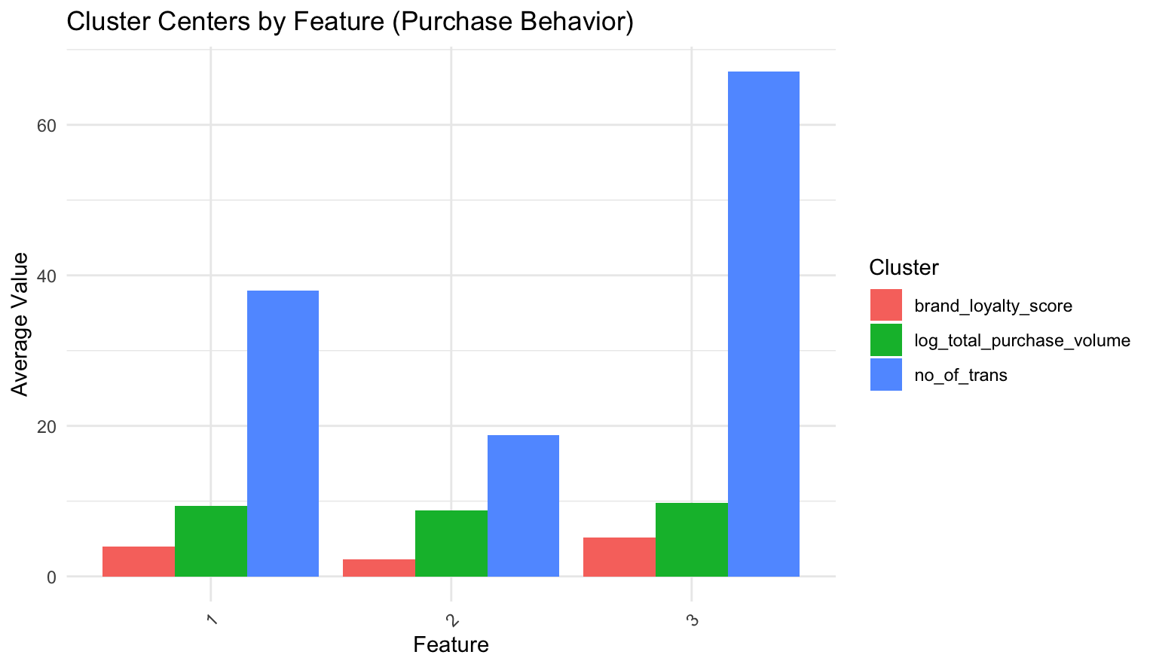
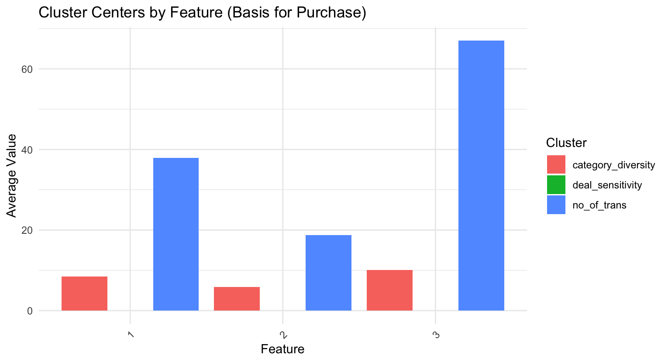
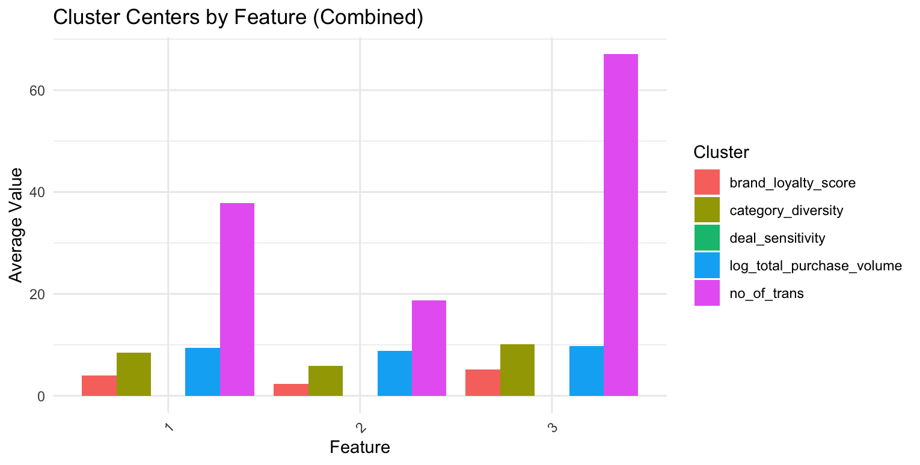
Clustering
Cluster 1: Moderate Buyers
Cluster 1: Promotion-Sensitive, Narrow Buyers
Cluster 1: Balanced, High Engagement Consumers
Cluster 2: High-Frequency Shoppers
Cluster 2: Balanced, Diverse Shoppers
Cluster 2: Promotion-Driven, Frequent Shoppers
Cluster 3: Low-Engagement Shoppers
Cluster 3: Variety-Seeking, Deal-Resistant Shoppers
Cluster 3: Variety-Seeking, Low Engagement Shoppers

Slide 15
Feature Selection
Task | Target Variable | Definition | Label | Predictors
Value-Conscious Classification | value_conscious | Consumers in the top 25% of spend or transaction counts within Clusters 1 and 2. | 1: Value-conscious 0: Not value-conscious | category_diversity, affluence_index, avg_price, no_of_trans
Brand Loyalty Classification | brand_loyalty | Consumers in the top 25% of brand runs within Clusters 1 and 2. | 1: Brand-loyal 0: Not brand-loyal | category_diversity, affluence_index, avg_price, no_of_trans
Brand Runs Prediction | brand_runs | Actual count of brand-specific purchases made by consumers in Clusters 1 and 2. | Continuous numeric value | category_diversity, affluence_index, avg_price, no_of_trans, total_volume

Slide 16
Classification Model Result
Value-Conscious Classification
Model | Accuracy | Sensitivity | Specificity
Logistic Regression | 81.5% | 75.4% | 84.8%
Random Forest | 84.57% | 87.62% | 78.95%
Brand Loyalty Classification Model
Model | Accuracy | Sensitivity | Specificity
Logistic Regression | 89.5% | 69.8% | 96.6%
Random Forest | 91.98% | 98.32% | 74.42%

Slide 17
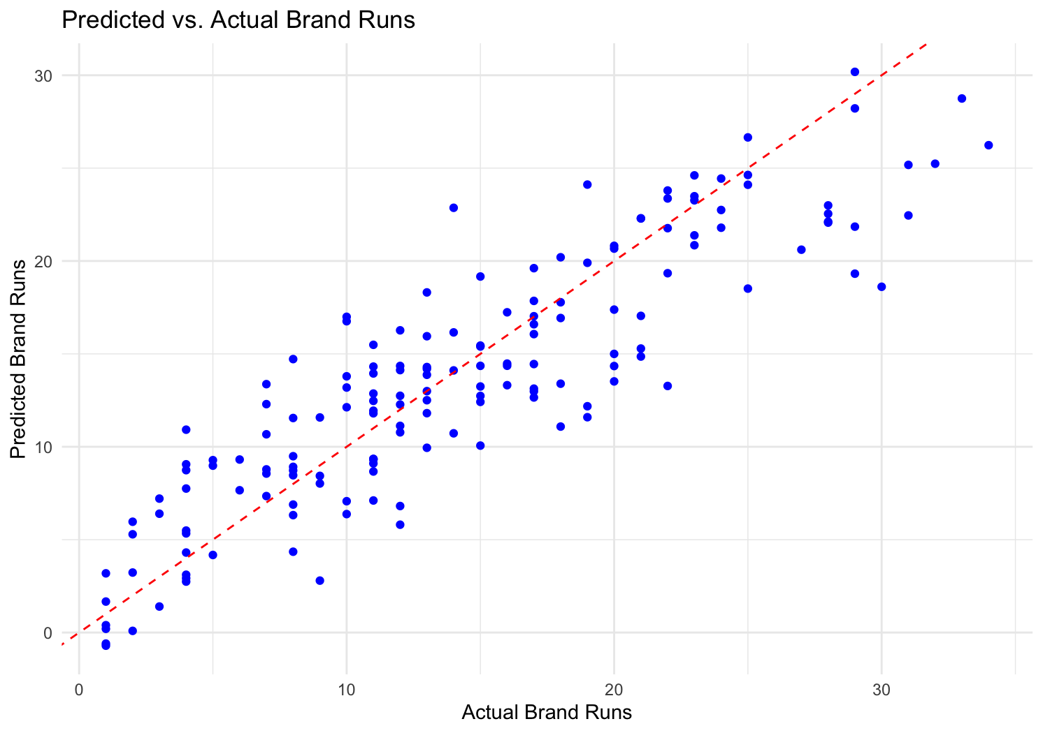
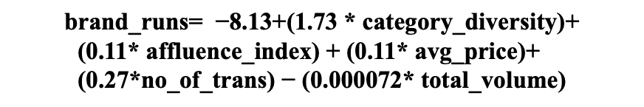
Regression - Brand Runs Prediction
Predictor | Estimate | Std. Error | t-value | p-value | Significance
Intercept | -8.13 | 1.03 | -7.91 | <0.0001 | ***
category_diversity | 1.73 | 0.12 | 14.92 | <0.0001 | ***
affluence_index | 0.11 | 0.03 | 4.03 | <0.0001 | ***
avg_price | 0.11 | 0.06 | 1.69 | 0.0915 | .
no_of_trans | 0.27 | 0.03 | 10.43 | <0.0001 | ***
total_volume | -0.000072 | 0.000035 | -2.05 | 0.0414 | *
$$\text{brand}\text{_}\text{runs}\text{= −8.13+(1.73 ∗ }\text{category}\text{_}\text{diversity}\text{)+}$$
$$\text{(}\text{0.11}\text{∗ }\text{affluence}\text{_}\text{index}\text{) + (0.11∗ }\text{avg}\text{_}\text{price}\text{)+ (0.27∗}\text{no}\text{_}\text{of}\text{_}\text{trans}\text{) − (0.000072∗ }\text{total}\text{_}\text{volume}\text{)}$$
Metric | Value
Mean Absolute Error (MAE) | 2.93
Mean Squared Error (MSE) | 14.08
Root Mean Squared Error (RMSE) | 3.75
Mean Absolute Percentage Error (MAPE) | 32.42%

Slide 18
Key Insights
Consumer Segmentation:
Three distinct consumer segments were identified through clustering:
Balanced, High Engagement Consumers: Consistent buyers with diverse category preferences.
Promotion-Driven, Frequent Shoppers: Highly responsive to deals and frequent buyers.
Variety-Seeking, Low Engagement Shoppers: Selective buyers with diverse product interests.
Transaction Frequency as a Key Driver:
Transaction frequency consistently emerged as a critical variable across clustering, classification, and regression tasks, strongly influencing consumer behavior and loyalty.
Category Diversity and Loyalty:
Consumers engaging with a broader range of product categories demonstrated higher loyalty, offering opportunities for cross-category marketing strategies.
Promotional Responsiveness:
Deal sensitivity varied significantly across segments, underscoring the need for tailored promotional campaigns targeting specific consumer behaviors.
Predictive Model Accuracy:
Classification models effectively identified value-conscious consumers (Random Forest accuracy: 84.57%) and brand-loyal consumers (Random Forest accuracy: 91.98%). Regression models provided actionable insights into repeat brand purchases.

Slide 19
Recommendations & Conclusion
Enhance Loyalty Programs:
Focus on high-frequency and value-conscious shoppers by introducing tiered rewards and exclusive offers to incentivize consistent purchases.
Target Low-Engagement Shoppers:
Develop personalized campaigns with discounts or curated product recommendations to re-engage inactive consumers.
Cross-Category Promotions:
Leverage insights on category diversity to promote complementary products and encourage broader purchasing behavior.
Data-Driven Campaigns:
Implement deal-specific marketing strategies for promotion-driven shoppers and emphasize product quality for variety-seeking consumers.

Slide 20
Thank
You!
Any Question?

